Slide 1
Center for Lyme Action FY25 Appropriations Requests
February 21, 2024

Slide 2
The Problem with Lyme Disease

Slide 3
FY25 Appropriations Requests
1. $30M – CDC – Fully Fund Kay Hagan Tick Act (Vector-borne disease)
FY23 $18.5M
FY24 up to $27.5M
2. $5M – HHS LymeX Funding
FY23 $0
FY24 up to $5M
3. $30M – CDC – Fund Lyme disease prevention programs
FY23 $26M
FY24 $26M
4. $135M – NIH NIAID Lyme disease research
FY23 $119M
FY24 Up to $125M+
5. $9M – DOD CDMRP
FY23 $7M
FY24 Up to $7M

Slide 4
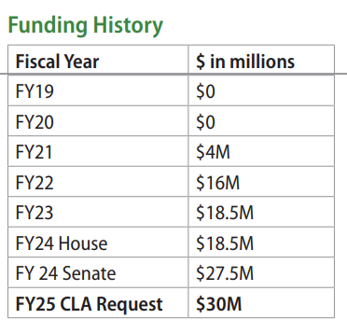
1. Fully Fund the Kay Hagan Tick Act REQUEST $30M
Centers for Disease Control and Prevention (CDC)
Authorization bill signed into law in 2019
Recommends $30M each year
$10M funds Centers of Excellence for research grants
$20M funds states and tribes for prevention and response

Slide 5
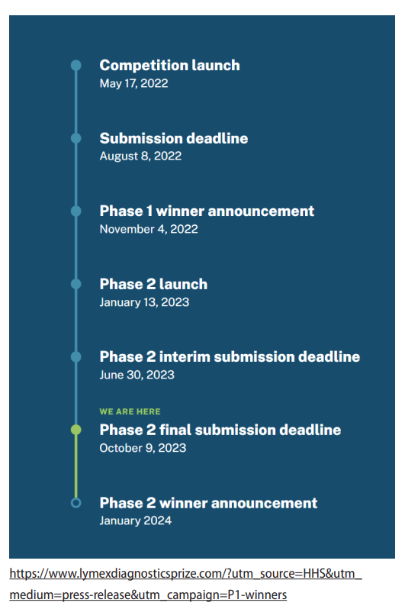
2. Fund HHS LymeX Innovation Accelerator REQUEST: $5M
Office of the Secretary, HHS
$25M public-private partnership with Steven and Alexandra Cohen Foundation
Foundation funds prize challenges for Lyme diagnostics
Phase 2 winners just announced
$5M needed for federal implementation

Slide 6
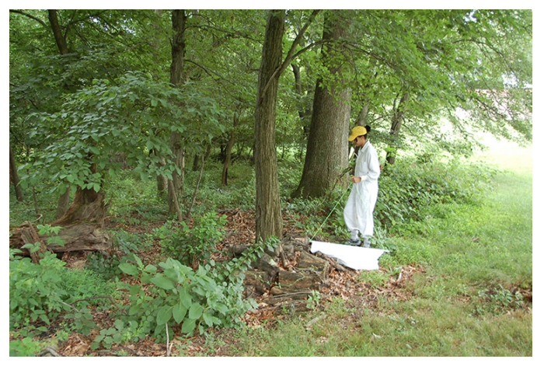
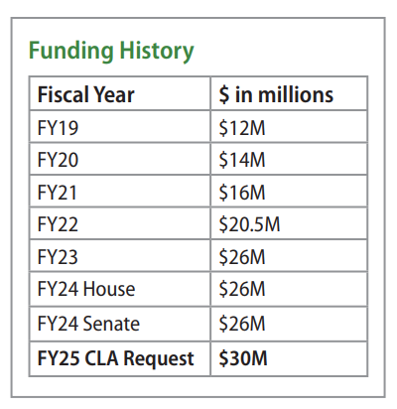
3. Fund Lyme & Tick-borne disease prevention programs REQUEST: $30M
Centers for Disease Control and Prevention (HHS CDC)
Bolster critical prevention programs and public awareness efforts
Develop better tick repellents
Improve TickNET surveillance networks and accurately determine disease burden

Slide 7
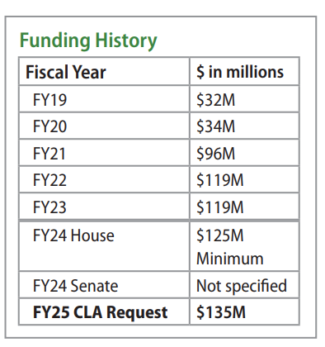
4. Fund NIH Lyme disease and other tick-borne disease research REQUEST: $135M
National Institute of Allergy and Infectious Diseases (HHS NIH NIAID)
CDC estimates at least 476,000 (cases) Americans get Lyme disease in the US each year
Only $106 per patient is allocated toward Lyme funding for NIH NIAID research
Underfunded compared to more rare infectious diseases:
West Nile (1,132 cases) - $20,070 per patient
Malaria (2000 cases) - $108,396 per patient

Slide 8
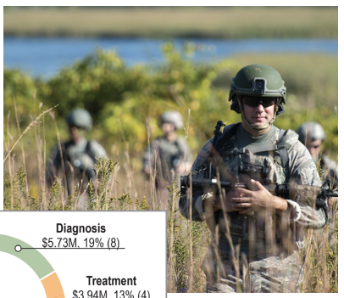
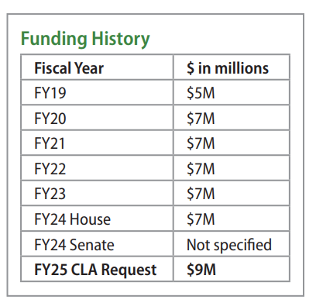
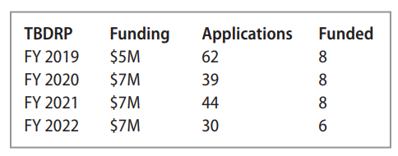
5. Fund Defense Peer-reviewed Tickborne Disease Research REQUEST: $9M
Department of Defense
Peer-Reviewed Tickborne Disease Research under the Congressionally Directed Medical Research Program within Department of Defense (DOD CDMRP TITLE V)
Unique peer review includes government experts and Lyme community experts
Funded just 20% of proposals in 2022, could fund more with additional resources

Slide 9
FY25 Appropriations Requests
1. $30M – CDC – Fully Fund Kay Hagan Tick Act (Vector-borne disease)
FY23 $18.5M
FY24 up to $27.5M
2. $5M – HHS LymeX Funding
FY23 $0
FY24 up to $5M
3. $30M – CDC – Fund Lyme disease prevention programs
FY23 $26M
FY24 Up to $26M
4. $135M – NIH NIAID Lyme disease research
FY23 $119M
FY24 Up to $135M
5. $9M – DOD CDMRP
FY23 $7M
FY24 Up to $7M

Slide 10
Q&A

